Slide 1
Operations Research
CSC 434
Lecture 6
Oluwambo Olowe

Slide 2
duality theorem
The Duality Theorem in Operations Research links a primary (primal) Linear Programming problem with a secondary (dual) problem, stating that if one has a finite optimal solution, the other does too, and their optimal objective values are equal (Strong Duality).
This theorem provides economic insights (shadow prices), offers an alternative solution method (solving the easier problem), and establishes a fundamental relationship where the primal's minimum is the dual's maximum (Weak Duality), with potential for a "duality gap" in non-linear cases.

Slide 3
Key Concepts
Primal Problem: The original optimization problem (e.g., maximizing profit).
Dual Problem: The associated problem, derived from the primal, using the same data but from a different perspective (e.g., maximizing value of resources).
Weak Duality: The objective value of any feasible primal solution is always greater than or equal to the objective value of any feasible dual solution (for a maximization primal/minimization dual).
Strong Duality: If either the primal or dual has a finite optimal solution, both do, and their optimal objective values are id\entical (no duality gap).

Slide 4
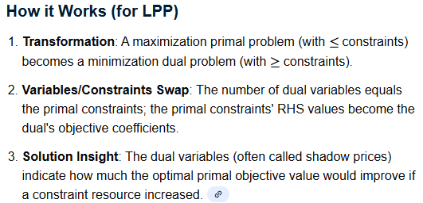
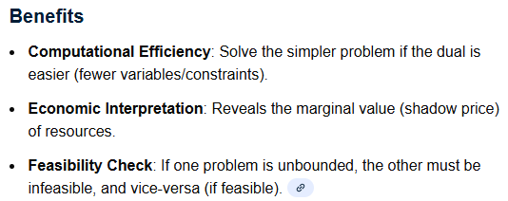
,

Slide 5

Duality Theory

Slide 6
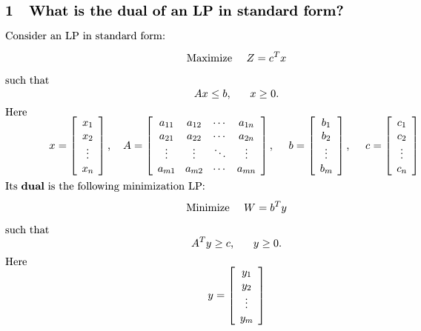
,

Slide 7
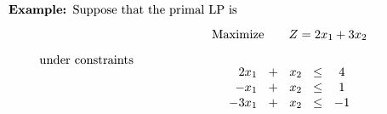
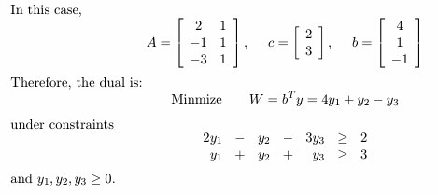
,

Slide 8
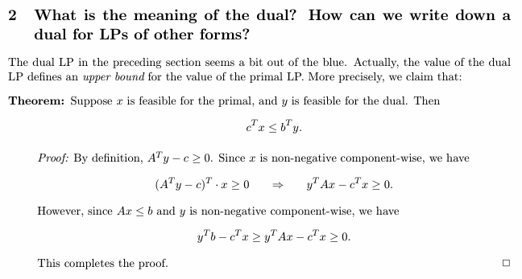
,
.

Slide 9
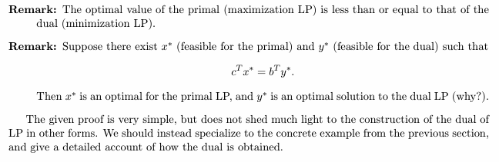
,

Slide 10
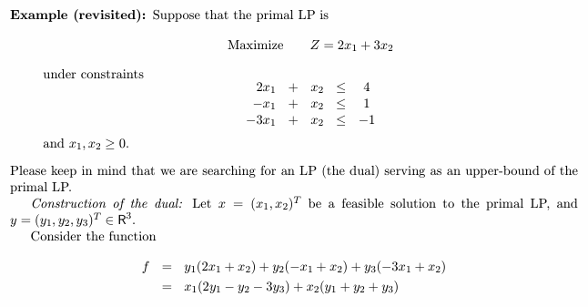
,
,

Slide 11
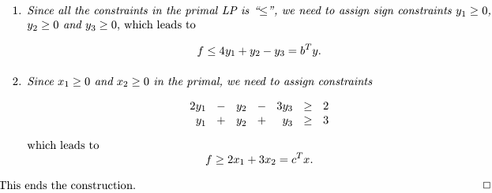
,
.

Slide 12
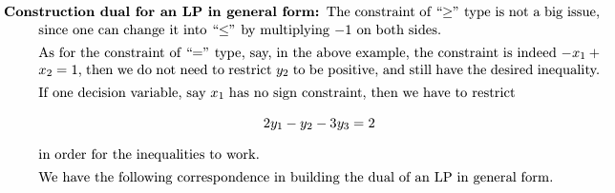
,
.

Slide 13
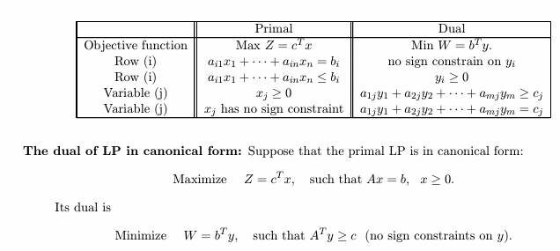
,
,

Slide 14
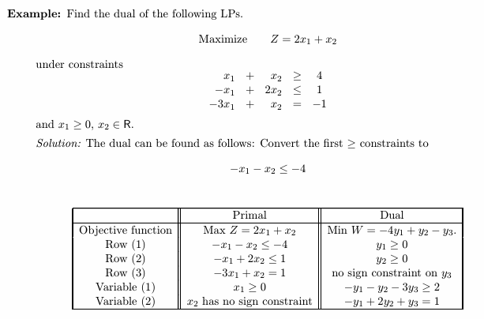
.
,

Slide 15
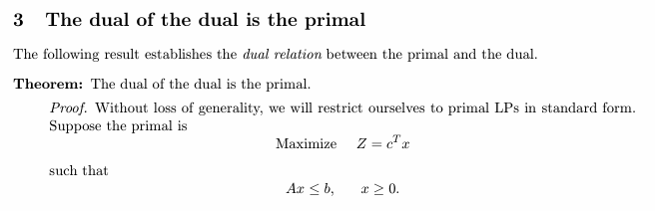
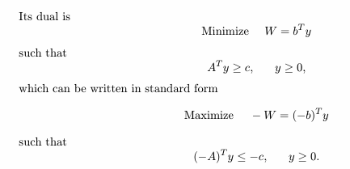
,

Slide 16
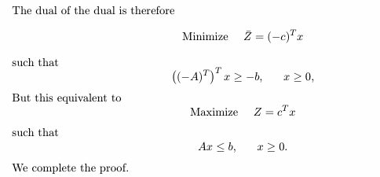
,
.

Slide 17
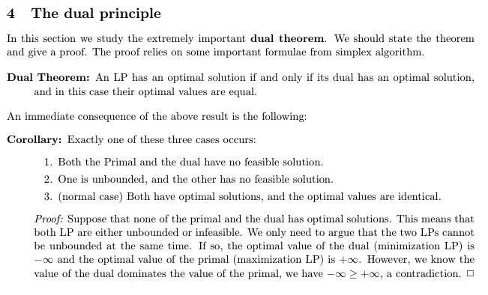
,
,

Slide 18
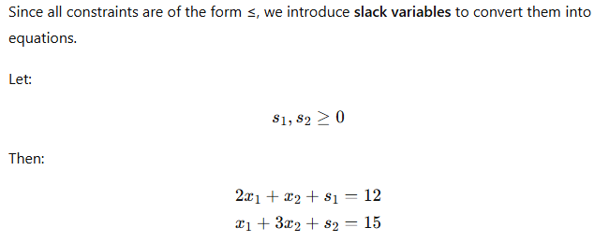

,
,

Slide 19
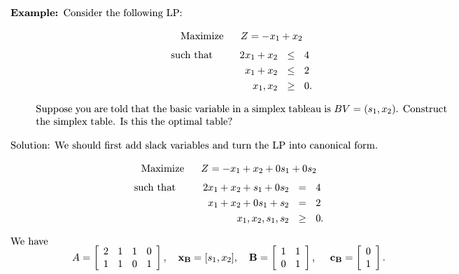
,
,

Slide 20
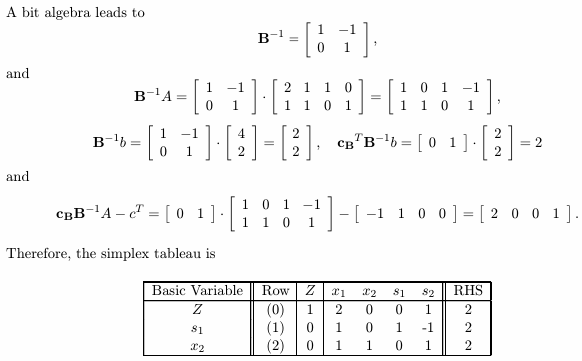
,
,
This table is optimal

Slide 21
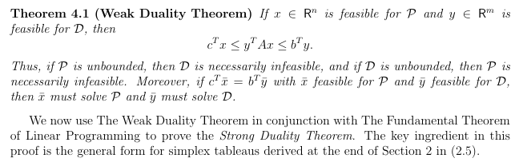
,
,

Slide 22
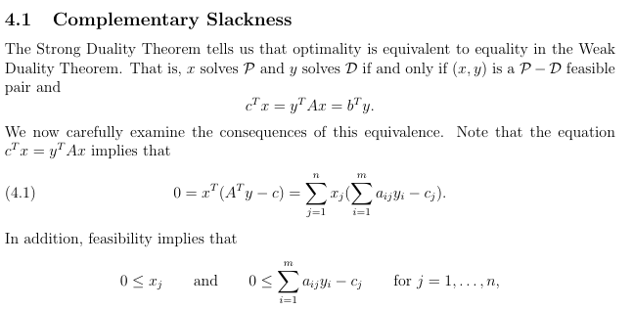
,
,

Slide 23
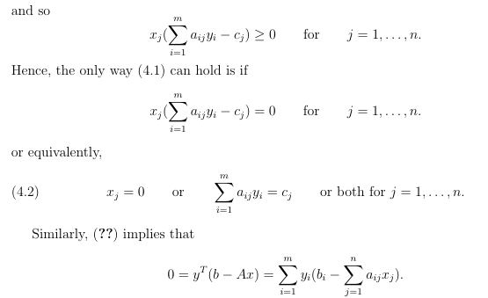
,
,

Slide 24
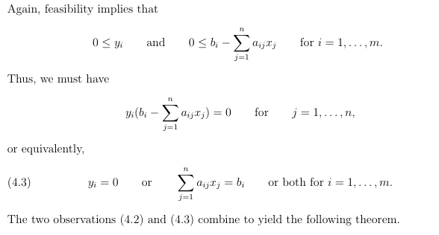
,
,

Slide 25
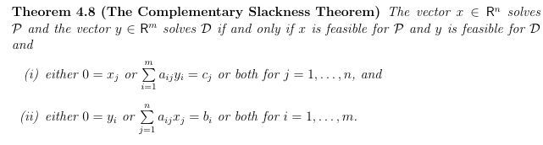
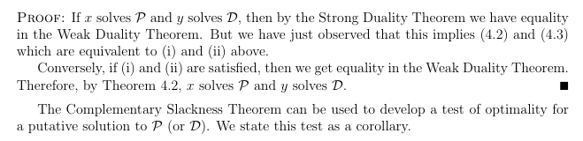
,
,

Slide 26
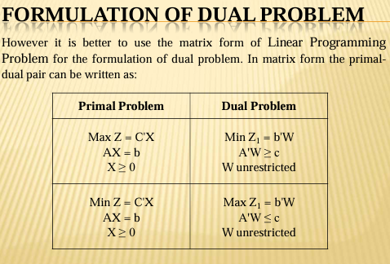
,
,

Slide 27
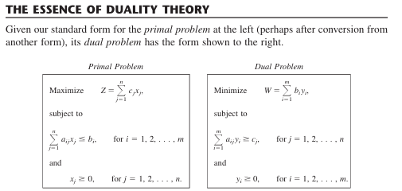
,
,

Slide 28
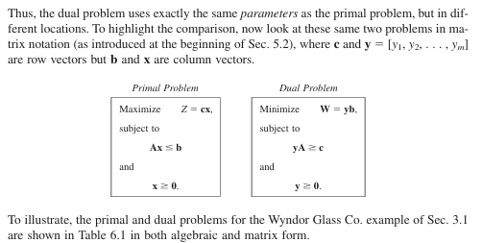
,
,

Slide 29




